Slide 1




Detecting DoS Attack in Smart Home IoT Devices Using a Graph-Based Approach
Ramesh Paudel¹, Timothy Muncy², William Eberle¹
¹Tennessee Tech University
²East Tennessee State University
2019 IEEE International Conference on Big Data
IoTBB’2019
December 9-12, 2019, Los Angeles, CA, USA

Slide 2
Agenda
Smart
Homes
& IoT
Devices
Experiments
&
Results
Marketing
Problems
Training
Assesment
GODIT
Technology
Graph-based Outlier Detection in Internet of Things

Slide 3


Smart Home
Internet of Things (IoT) devices are designed to optimize, automate, and improve quality of life.
Device for Energy Management, Cameras, Appliances, Health-Monitor, Controllers, etc. are actively connected to the internet.
A smart home is a residence that uses IoT devices to enable the remote monitoring and management of appliances and systems.
[1]
Notes:
Internet of Things: The Internet of Things is a system of interrelated computing devices that are provided with unique identifiers and the ability to transfer data over a network without requiring human-to-human or human-to-computer interaction.
Energy Management:- Belkin Motion Sensor, LIFX Lightbulb, Phlip Hue Lightbulb, iHome Power Plug, Belkin Switch, TP Link Power Plug
Health-Monitor:- Sleep sensor, blipcare BP machine, Air Quality Monitor, Smoke Alarm, Netatmo Weather station
Cameras:-
Controller/Hubs:- Amazon Echo, Hue Bridge, Samsung SmartThings

Slide 4
Statistics [2]
$1.1 trillion
IoT market
by 2026
$190 billion
IoT market
value
in 2018
IoT Vulnerabilities:
IoT devices can be attacked within 5 min after connecting to the internet
32.7 million IoT malware attack in 2018 ( ↑ by 55% in 2019)
25 billion
IoT device
By 2025

Slide 5
Attack Examples
2016 Mirai
Botnet DDoS
Attack
2017 Casino
Fish Tank
Hacking
Mirai malware amassed IoT devices (Cameras + DVR Players) as botnet to do DDoS attack on Dyn Infrastructure.
100,000 malicious endpoints
1.2Tbps attack strength
Took down internet of East Cost
Hacker got into the fish tank sensor
Used it to move around into other areas of the network and sent out data
10 GB of data were sent out to a device in Finland.
Reported by Darktrace
Notes:
Mirai Botnet: DVR (Digital Video recorder) scan for open Telnet ports, attempted to log in default passwords, amass a botnet army to attack Dyn, an Internet infrastructure company headquartered in New Hampshire, 3 wave of attack
Casino Fish Tank: A North American casino fish tank with sensors connected to a PC that regulated the temperature, food and cleanliness of the tank.

Slide 6

What is the problem?
Current Threat Detection Approaches:
Methods | Drawbacks
Signature-based | Ineffective to detect new attacks and variants of known attacks.
Anomaly-based | Learning the scope of the normal behavior is not a simple task. Hence has high false positive rates.
Specification-based | Human expert should manually define the rules of each specification. This may not adapt to different environments and could be time-consuming and error-prone.
Hybrid Approach | Computationally expensive
Current security solutions in IoT devices:
Has little to no significant security (like password).
Computationally expensive and high communication overhead.
Unscalable as they require known attack signatures or full packet inspection.
Notes:
→ Use default password and do not change.
Signature-based:- Detect attacks when system or network behavior matches an attack signature stored in the internal databases.
Anomaly-based:- Compare the activities of a system at an instant against a normal behavior profile (using statistical techniques or machine learning algorithms) and generates the alert whenever a deviation from normal behavior exceeds a threshold
Specification-based:- Specification is a set of rules and thresholds that define the expected behavior for network components such as nodes, protocols, and routing tables.
Hybrid Approach:- Use concepts of signature-based, specification-based and anomaly-based detection to maximize their advantages and minimize the impact of their drawbacks.

Slide 7

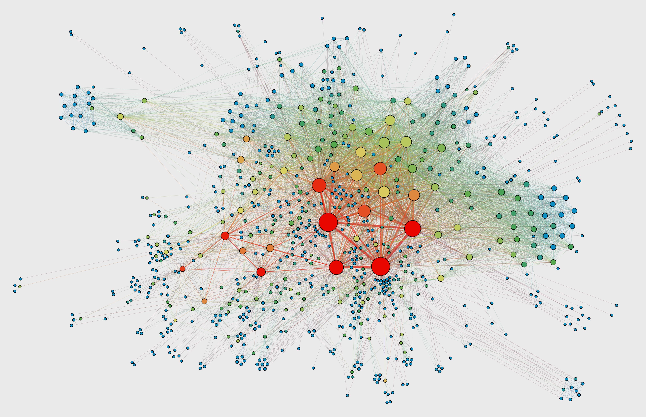
Graph-based Approach
A graph naturally represents highly relational and inter-dependent data
In IoT network, device can be treated as a node and the communication as edges.
Anomalies could exhibit themselves as relational.
Only need the source and destination IP to build a network graph.
Do not need any extra information like traffic packet
size, protocol, etc.,
Why Graphs?

Slide 8
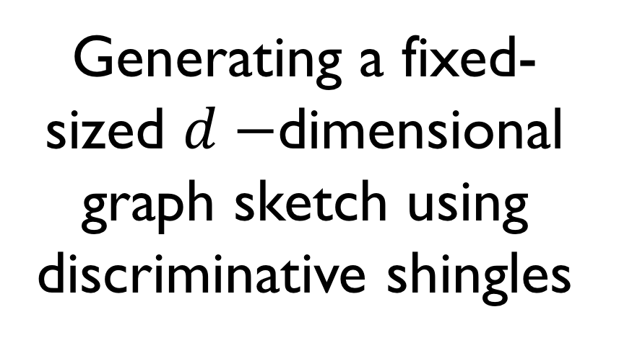
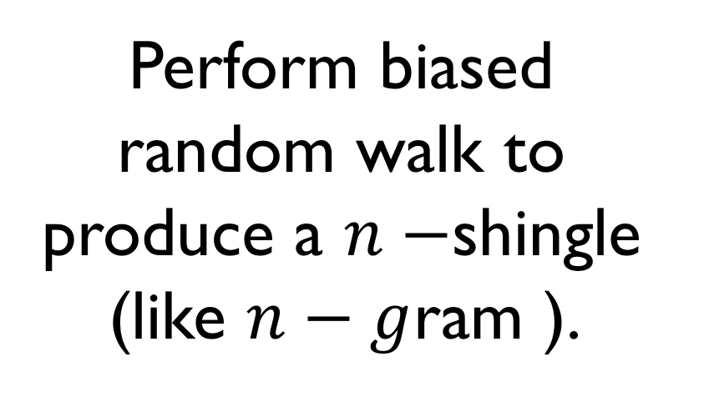
Graph-based Outlier Detection in Internet of Things (GODIT)
Random
Walk
Training
Graph
Sketching
Assesment
DoS Attack
Detection
Technology
Perform biased random walk to produce a $n−$shingle (like $n−g$ram ).
Generating a fixed-sized $d−$dimensional graph sketch using discriminative shingles
DoS attack detection in graph stream using
Robust Random Cut Forests (RRCF)

Slide 9
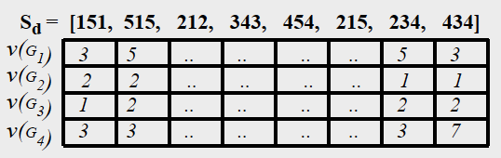



GODIT Overview
Represents smart home IoT traffic as a real-time graph stream
Perform biased random walk to generate a $n−$shingle (like $n−g$ram ).
Find top $d−$discriminative shingles using entropy-based measures.
Generating a fixed-sized $d−$dimensional graph sketch using discriminative shingles
Sketch vector hold cost of $Sd$ in each graph $Gt$.
Anomaly (DoS) detection on graph sketches
The similar graph share higher proximity (shown by Jaccard similarity) and dissimilar graph are mapped far
Notes:
The similar graph share higher proximity (shown by Jaccard similarity)

Slide 10
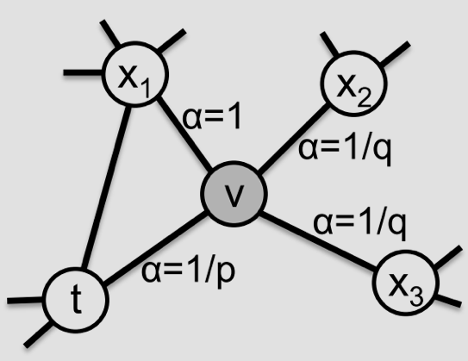
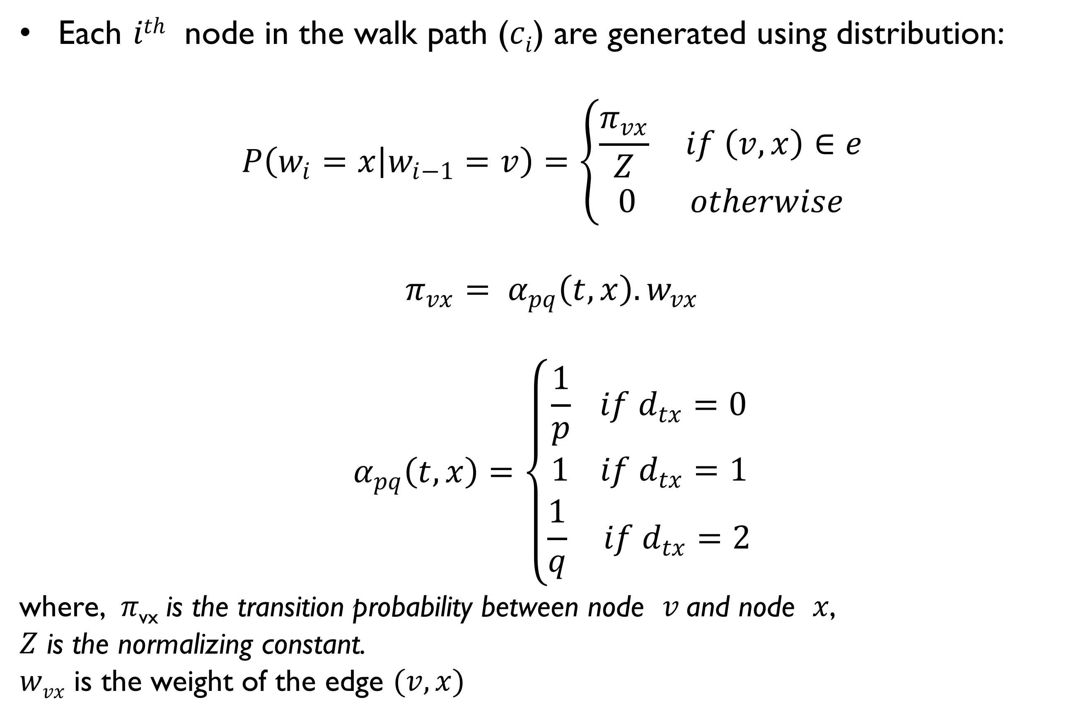
Shingling using Biased Random Walk
Each $ith$ node in the walk path ($ci$) are generated using distribution:
$$P\left(w_{i}=x | w_{i−1}=v\right)=\left\{\begin{aligned}\frac{π_{vx}}{Z} if \left(v,x\right)∈e \\ 0 otherwise\end{aligned}\right.$$
$${π_{vx}= α}_{pq}\left(t,x\right).w_{vx}$$
$$α_{pq}\left(t,x\right)=\left\{\begin{aligned}\frac{1}{p} if d_{tx}=0 \\ 1 if d_{tx}=1 \\ \frac{1}{q} if d_{tx}=2\end{aligned}\right.$$
where, $π\text{vx}$ is the transition probability between node $v$and node $x$,
$Z$ is the normalizing constant.
$wvx$ is the weight of the edge $(v, x)$
[9]
Notes:
Interpolate between BFS and DFS usig parameter $p$and $q$
If a random walk just traversed the edge $(t, v)$and is currently at node $v$, the next step to the node $x$leading from the current node $v$can be decided using transitional probability $π\text{vx}=αpq\left(t,x\right).wvx$
where $wvx$ is the weight of the edge $(v, x)$and
The parameter p controls the likelihood of revisiting an older node in the walk
The high value of q provides a walk with a local view (equivalent to BFS behavior)
a low value of q provides a walk away from the current node (equivalent to DFS behavior).

Slide 11
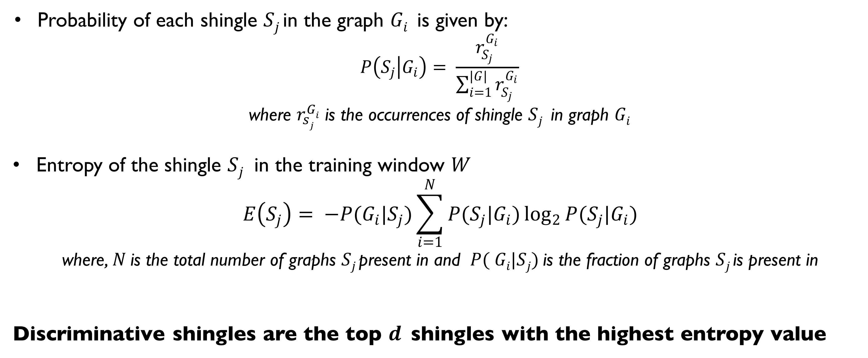
Generating Discriminative Shingle
Probability of each shingle $Sj$in the graph $Gi$ is given by:
$$P\left(S_{j} | G_{i}\right)= \frac{r_{S_{j}}^{G_{i}}}{\sum_{i=1}^{|G|}{r_{S_{j}}^{G_{i}}}}$$
where $r_{sj}^{Gi}$ is the occurrences of shingle $Sj$ in graph $Gi$
Entropy of the shingle $Sj$ in the training window $W$
$$E\left(S_{j}\right)= −P(G_{i}|S_{j})\sum_{i=1}^{N}{P(S_{j}|G_{i})\log_{2}{P(S_{j}|G_{i})}}$$
where, $N$is the total number of graphs $Sj$present in and $P( Gi|Sj)$is the fraction of graphs $Sj$is present in
Discriminative shingles are the top $d$shingles with the highest entropy value

Slide 12
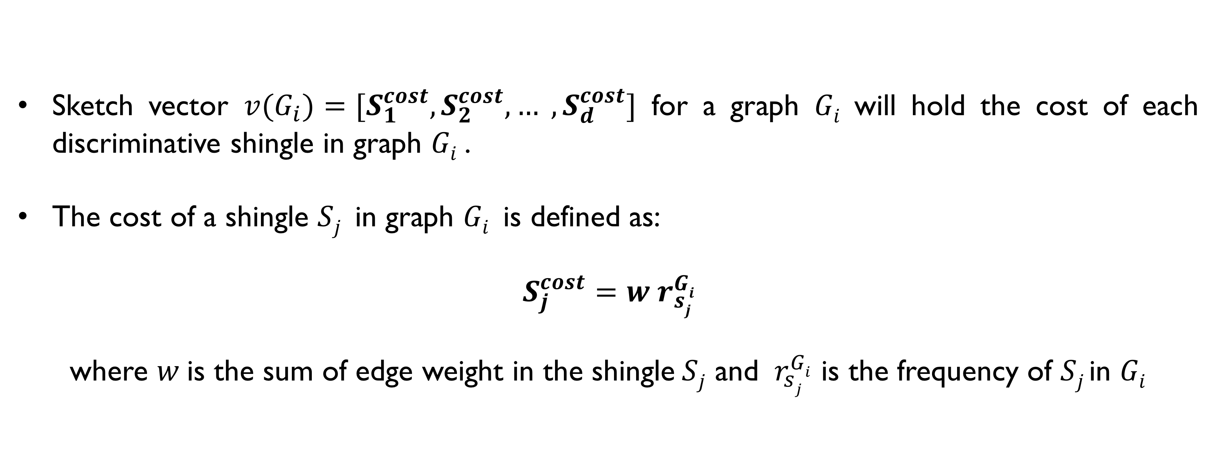
Graph Sketching
Sketch vector ${v(G}_{i})=[S_{1}^{cost},S_{2}^{cost}, … ,S_{d}^{cost}]$ for a graph $Gi$will hold the cost of each discriminative shingle in graph $Gi$.
The cost of a shingle $Sj$in graph $Gi$is defined as:
$S_{j}^{cost}=w r_{sj}^{Gi}$
where $w$is the sum of edge weight in the shingle$Sj$ and $r_{sj}^{Gi}$ is the frequency of $Sj$in $Gi$

Slide 13
Anomaly Detection
The anomaly detection is performed by using the state-of-the-art Robust Random Cut Forests (RRCF) [4].
RRCF algorithm is an unsupervised ensemble method for detecting outliers in streaming data.
We initialize RRCF using 100 trees and 256 samples.
RRCF initializes the forest of 100 trees by using the sketch vector of the first 256 graphs.

Slide 14
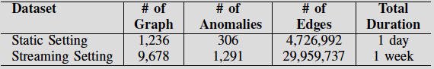
Dataset
Taken from the University of New South Wales Sydney (UNSW Sydney) smart home test-bed [8].
Smart home that have 28 IoT devices as well as non-IoT devices.
Each DoS attack lasts for 10 minutes and is launched with the maximum limit of 1, 10 or 100 packets per second.
Based on this ground truth, if an individual graph contains at least 50 edges belonging to a DoS attack, the graph was labeled anomalous.

Slide 15
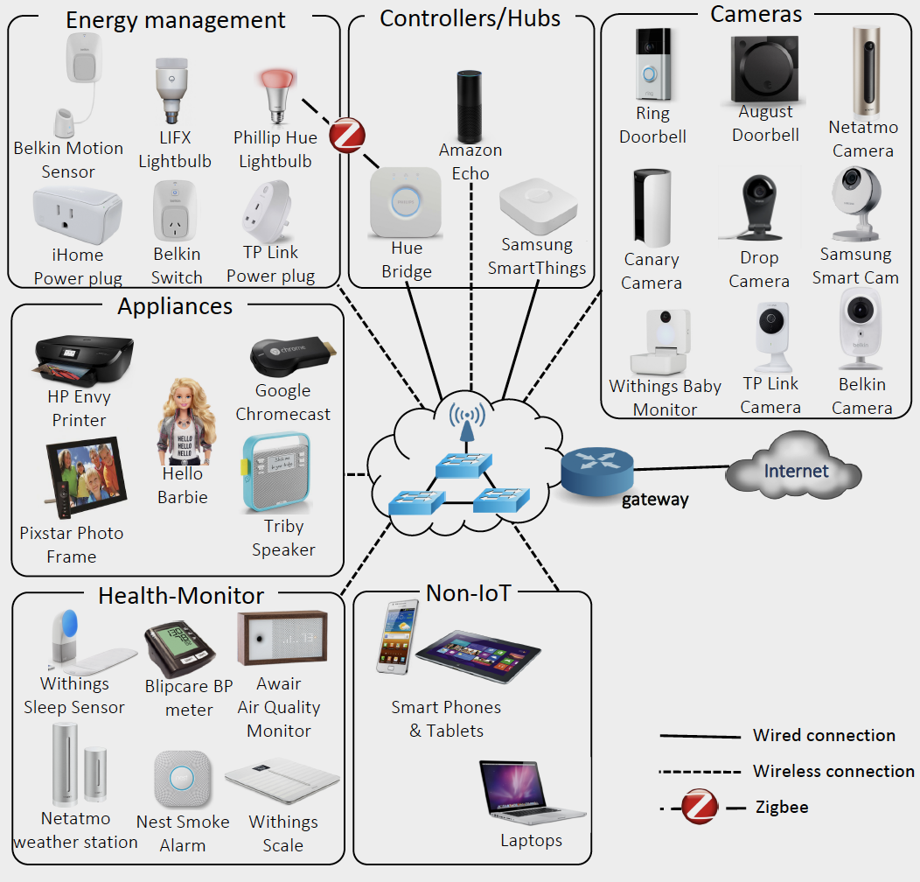
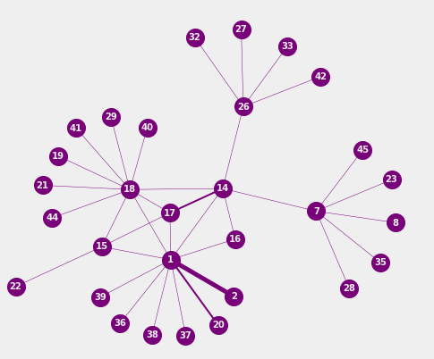

Data Preprocessing
[8]

Slide 16
Static Settings:
Demonstrate that the proposed approach can classify normal and DoS attack graphs.
One full day of data (June 01, 2018) where 5 IoT devices are involved in DoS attacks.
Uses the sketch vector as input to the supervised machine learning algorithms: decision tree, support vector machine, gradient boosting, and random forest.
Compare with standard machine learning approach developed by Doshi et al. [5].
Doshi et al. [5] method primarily relies on the use of stateless features like packet size, inter-packet time interval, and protocol.

Slide 17
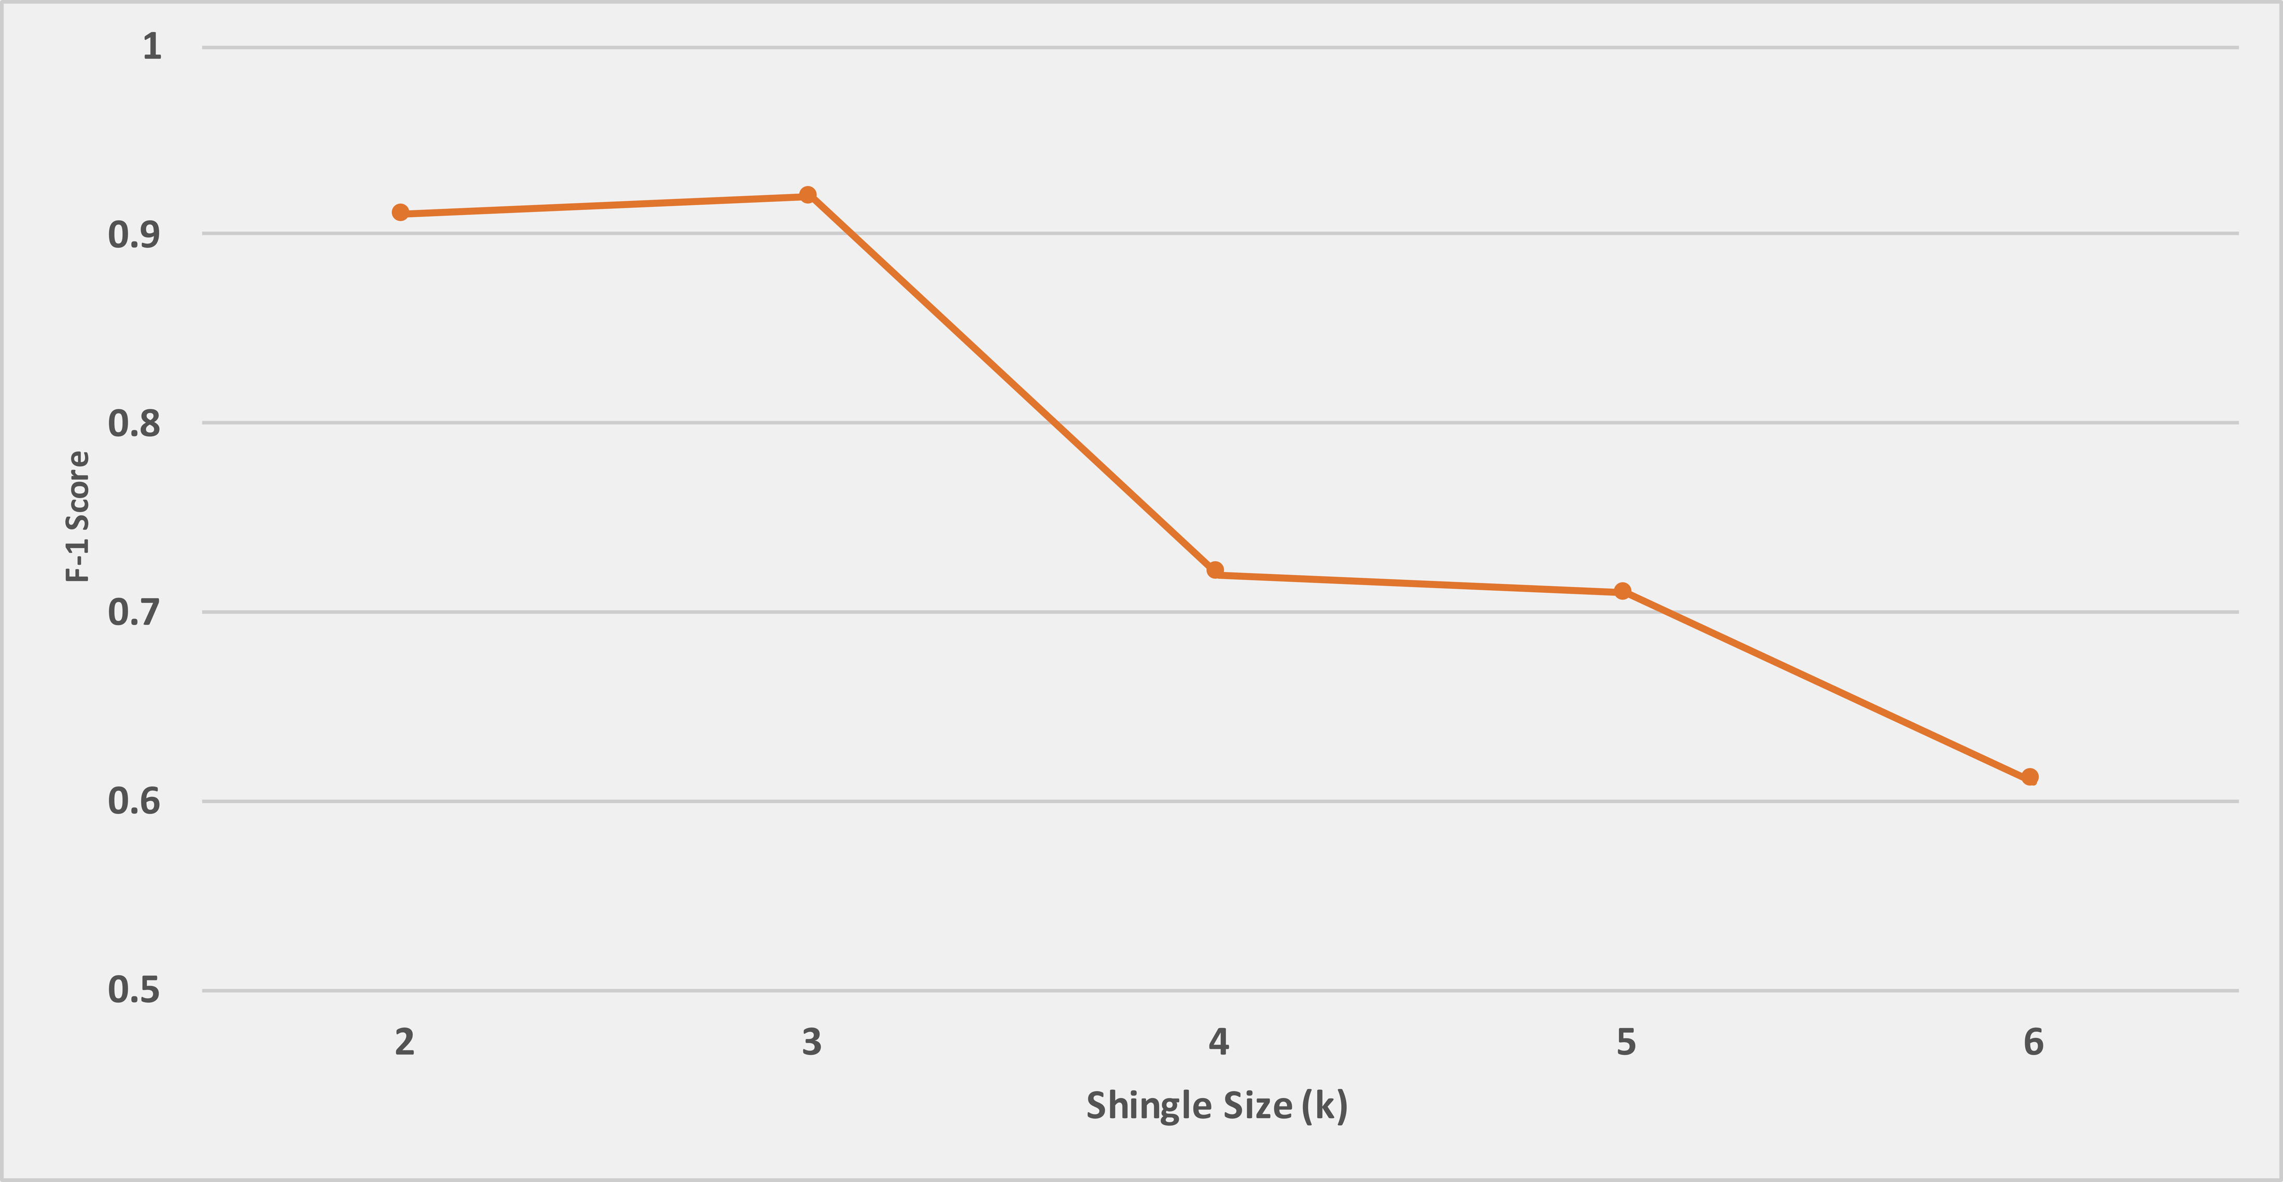
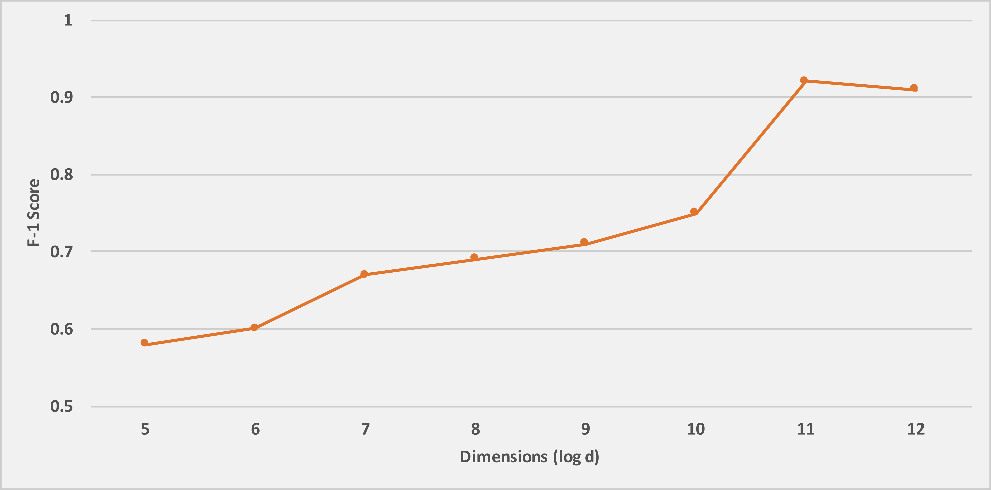
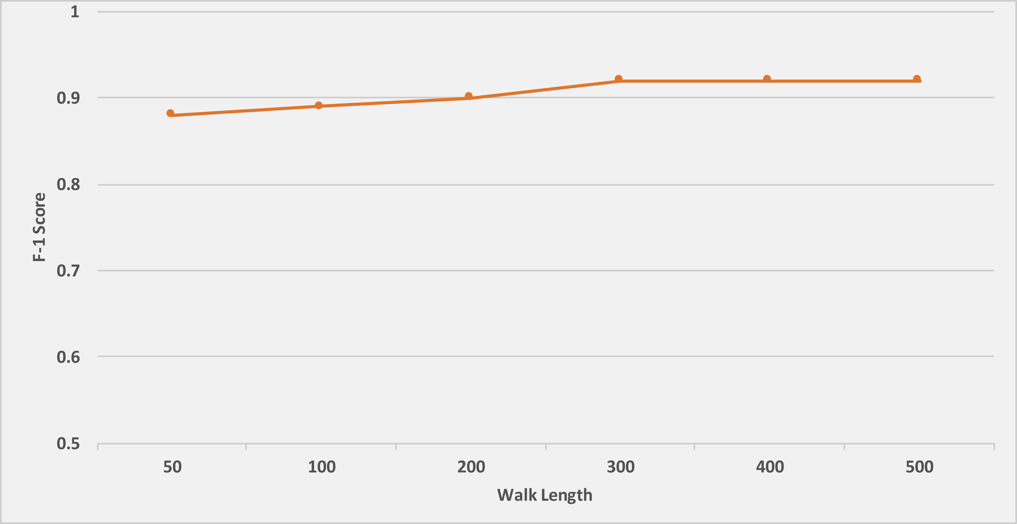
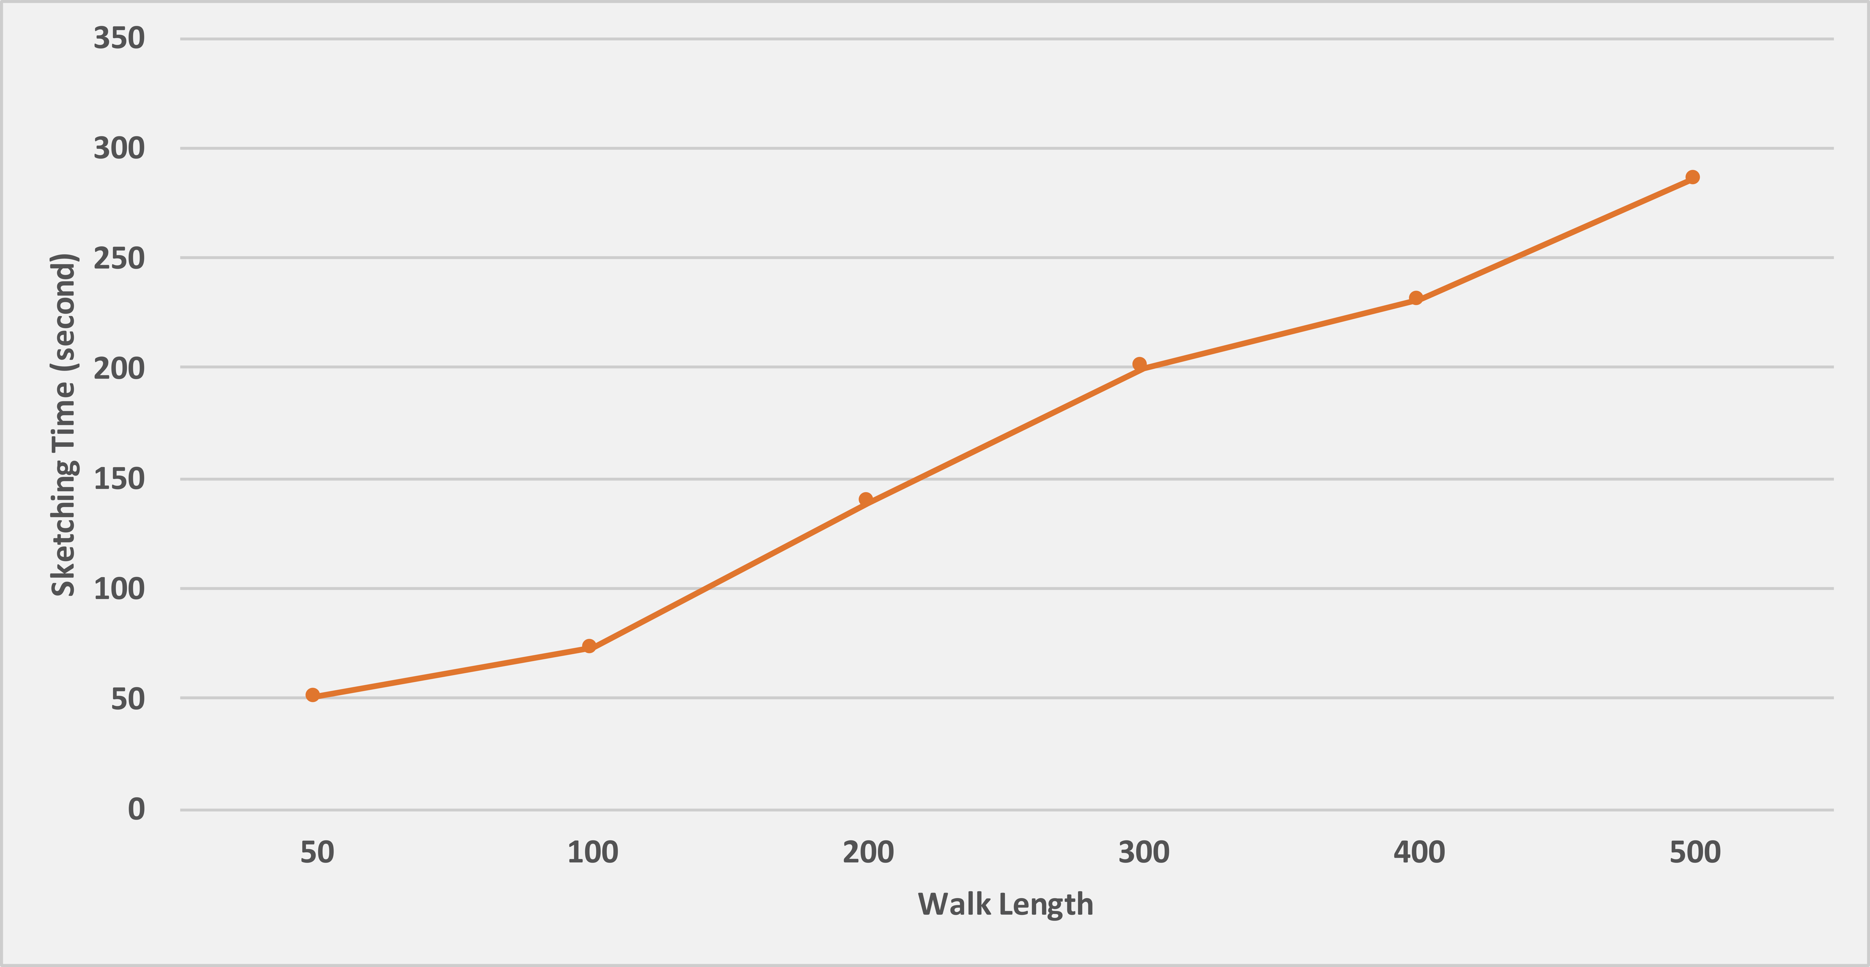
Parameter Sensitivity

Slide 18
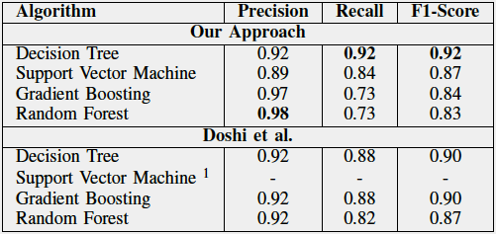
Results

Slide 19
Streaming Settings:
One week of data with 29.9 million traffic packets.
Each graph represents 1-minute of network traffic.
Total 9,879 graphs each coming every minute in the graph stream.
First 25% of the data is used as a training set to generate discriminative shingles and anomaly detection is done in subsequent 75% (7,280) of the data.
Compare against SpotLight [6] and StreamSpot [7].
Evaluated using precision and recall for top k anomalous graphs.

Slide 20
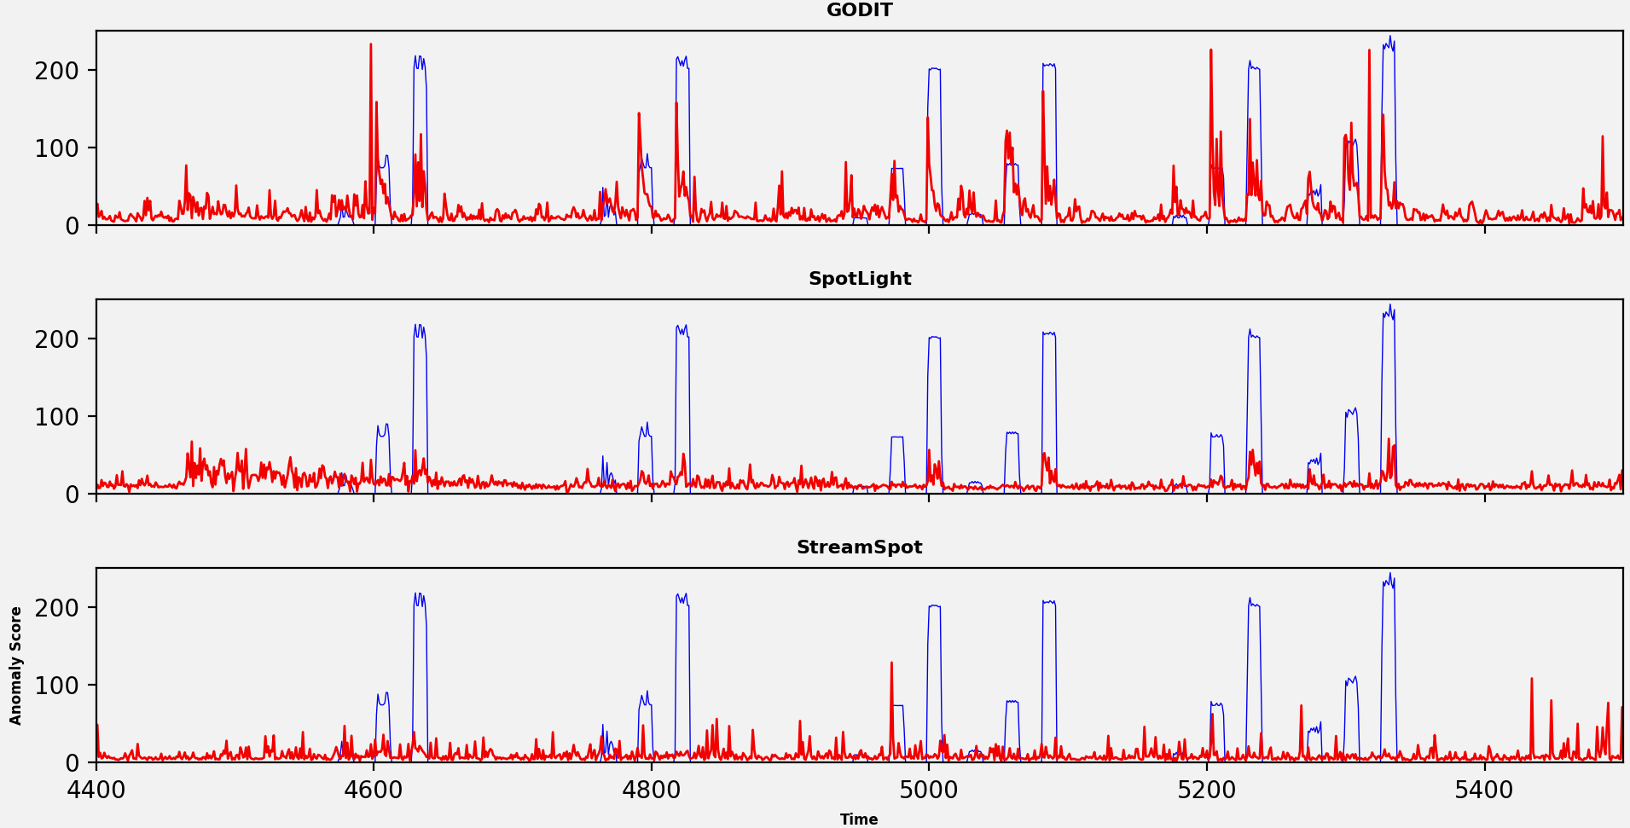
Results

Slide 21
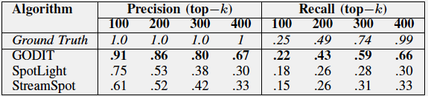
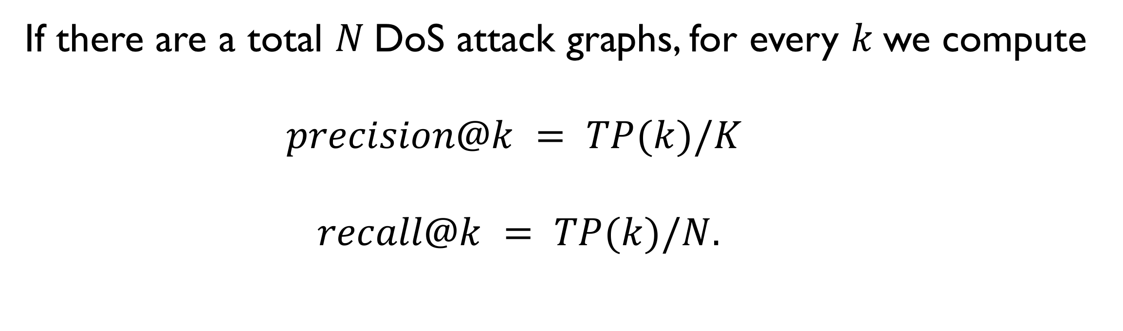
Results
If there are a total $N$DoS attack graphs, for every $k$we compute
$$precision@k = TP(k)/K$$
$$recall@k = TP(k)/N.$$
As RRCF is initialized based on the first 256 graphs, performance is reported on the subsequent 7,280 - 256 = 7,024 graphs, containing 404 ground truth anomalies (5.7% of total).
Notes:
As RRCF is initialized based on the first 256 graphs, performance is reported on the subsequent 7,280 - 256 = 7,024 graphs, containing 404 ground truth anomalies (5.7% of total).

Slide 22
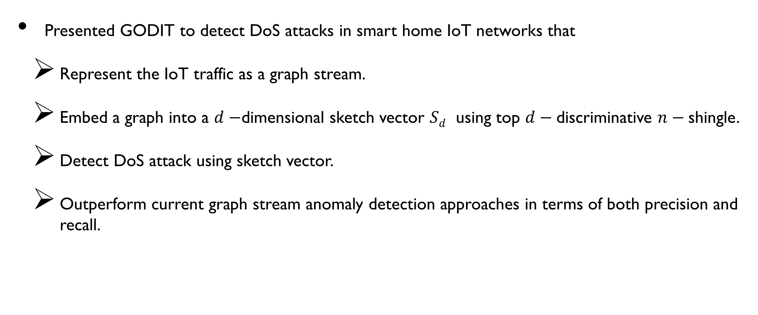
Conclusion
Presented GODIT to detect DoS attacks in smart home IoT networks that
Represent the IoT traffic as a graph stream.
Embed a graph into a $d−$dimensional sketch vector $Sd$ using top $d−$discriminative $n−$shingle.
Detect DoS attack using sketch vector.
Outperform current graph stream anomaly detection approaches in terms of both precision and recall.

Slide 23
Future Works
GODIT requires periodical training/updates to match the latest trends (while generating discriminative shingles) if the network traffic is going through the concept drift.
Neighborhood information is included (using BFS and DFS), but the structure of the graph (number of neighbors, degree, etc.) is omitted.
Would like to investigate an approach to integrate this structural information in our sketch vector, which would result in a rich set of information.

Slide 24
References:
https://medium.com/datadriveninvestor/10-amazing-cases-of-iot-applications-taken-from-the-real-life-a8682cdb48d0
https://securityboulevard.com/2019/09/20-surprising-iot-statistics-you-dont-already-know/
https://www.forbes.com/sites/leemathews/2017/07/27/criminals-hacked-a-fish-tank-to-steal-data-from-a-casino/
Guha, Sudipto, et al. "Robust random cut forest based anomaly detection on streams." International conference on machine learning. 2016.
Doshi, Rohan, Noah Apthorpe, and Nick Feamster. "Machine learning ddos detection for consumer internet of things devices." 2018 IEEE Security and Privacy Workshops (SPW). IEEE, 2018.
Eswaran, Dhivya, et al. "Spotlight: Detecting anomalies in streaming graphs." Proceedings of the 24th ACM SIGKDD International Conference on Knowledge Discovery & Data Mining. ACM, 2018.
Manzoor, Emaad, Sadegh M. Milajerdi, and Leman Akoglu. "Fast memory-efficient anomaly detection in streaming heterogeneous graphs." Proceedings of the 22nd ACM SIGKDD International Conference on Knowledge Discovery and Data Mining. ACM, 2016.
A. Hamza, H. H. Gharakheili, T. A. Benson, and V. Sivaraman, “Detecting volumetric attacks on lot devices via sdn-based monitoring of mud activity,” in Proceedings of the 2019 ACM Symposium on SDN Research. ACM, 2019, pp. 36–48.
A. Grover and J. Leskovec, “node2vec: Scalable feature learning for networks,” in Proceedings of the 22nd ACM SIGKDD international conference on Knowledge discovery and data mining. ACM, 2016, pp. 855–864.

Slide 25
Thank You

